Slide 1
Canvas part 2: SurfaceView
Advanced Android Development
Lesson 11

Slide 2

11.2 The SurfaceView class

Slide 3
Contents
SurfaceView
Working with SurfaceView

Slide 4
SurfaceView

Slide 5
SurfaceView
All Views in view hierarchy are rendered onto one Surface in the UI thread
A SurfaceView is a View in your app's view hierarchy that has its own separate Surface and renders behind app's surface
Surface refers to a lower-level drawing surface
Android system combines and renders surfaces

Slide 6
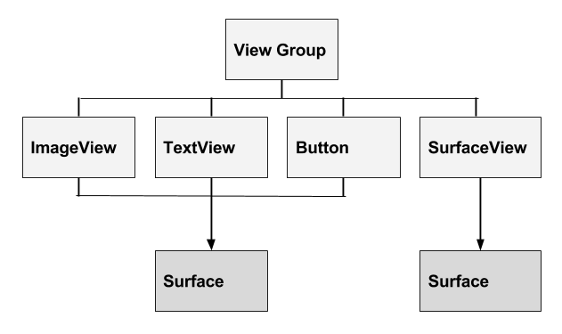
SurfaceView in View hierarchy

Slide 7
Draw off the UI Thread
SurfaceView makes it possible to draw to the Surface from a separate thread!
Long drawing actions have less impact on UI Thread

Slide 8
High-level steps
Start a thread
Lock the SurfaceView object's Canvas
Draw
Post to the Surface

Slide 9
Hardware acceleration
Starting with Android O, you can hardware-accelerate your SurfaceView
Important: SurfaceView is not hardware-accelerated in previous versions of Android. Depending on your app, you may need to consider performance trade-offs

Slide 10
Working with SurfaceView

Slide 11
Create a custom view
Create custom view that extends SurfaceView and implements Runnable
public class GameView extends SurfaceView implements Runnable{}

Slide 12
2. Get SurfaceHolder
Get a reference to the SurfaceView object's SurfaceHolder
Through this holder you control and monitor Surface
Holder is persistent even when a surface is not available
mSurfaceHolder = getHolder();

Slide 13
3. Check Surface availability
A Surface is only available while the SurfaceView object's window is visible
If your SurfaceView is not always visible, implement the surfaceCreated(SurfaceHolder) and surfaceDestroyed(SurfaceHolder) callback methods
Use these methods to discover when the Surface is created and destroyed and when window is shown and hidden

Slide 14
4. Thread run() method
Tips:
Always check whether a valid Surface is available
Lock the Canvas. If more than one thread drawing on this Surface, you must put this into a try/catch block
Draw on the Canvas
Unlock the Canvas and post its contents to the Surface

Slide 15
Example run() code
public void run() { // Variable declarations omitted
while (mRunning) {
if (mSurfaceHolder.getSurface().isValid()) {
canvas = mSurfaceHolder.lockCanvas();
// Android O
// canvas = mSurfaceHolder.lockHardwareCanvas();
canvas.save();
// Draw here
canvas.restore();
mSurfaceHolder.unlockCanvasAndPost(canvas);
} } }

Slide 16
5. Add resume() and pause()
5. Add pause() and resume()
resume() is called by onResume() in the Activity
pause() is called by onPause() in the Activity

Slide 17
Example resume() and pause()
public void resume() {
mRunning = true;
mGameThread = new Thread(this);
mGameThread.start();
}
public void pause() {
mRunning = false;
// join() waits for this
// thread to die.
try {
mGameThread.join();
}
catch (InterruptedException e){
}
Notes:
join() seems to be a badly named method!

Slide 18
6. Handle user interactions
Handle user-touches or any other data input that affects drawing

Slide 19
Only draw on a valid Surface
Ensure that the drawing thread only touches the underlying Surface while the Surface is valid, between SurfaceHolder.Callback.surfaceCreated() and SurfaceHolder.Callback.surfaceDestroyed()
Check in drawing thread's run() method:
if(mSurfaceHolder.getSurface().isValid()) ....

Slide 20
Threading semantics
All SurfaceView and SurfaceHolder.Callback methods will be called from the thread running the SurfaceView's window—typically the app's main thread
These methods need to correctly synchronize with any state that is also touched by the drawing thread
See Sending Operations to Multiple Threads

Slide 21
What's next?
Concept chapter: 11.2 The SurfaceView class
Practical: 11.2 Creating a SurfaceView object

Slide 22
END

